Slide 1


00
Monocular Depth Estimation
Rahul Nair

Slide 2
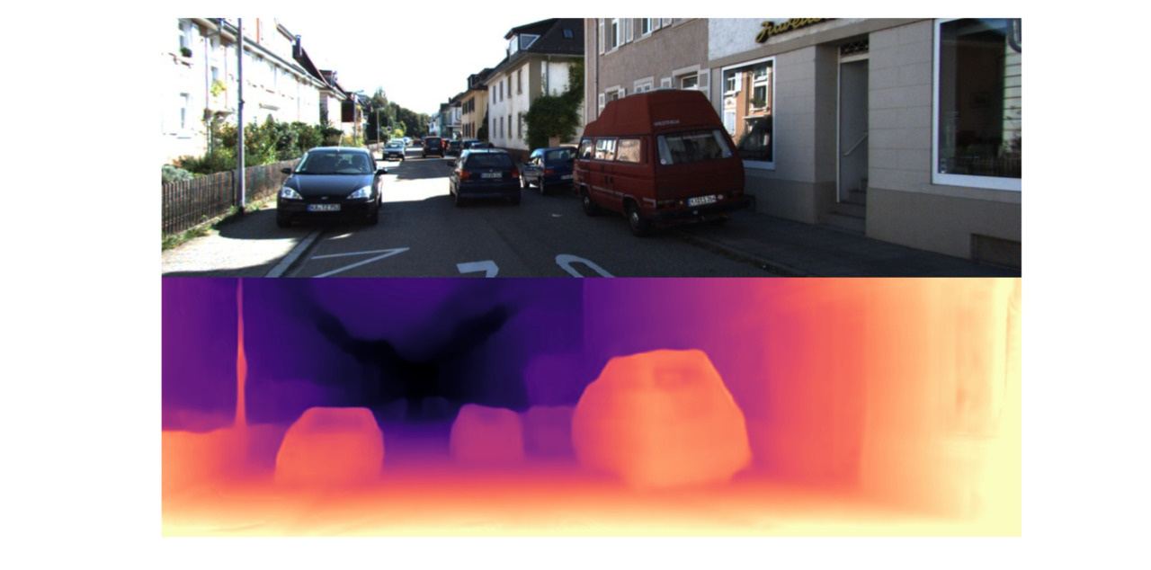
What is Monocular Depth estimation?
01
A computer vision task to predict the depth of objects in an image.
Requires the model to understand the relationship between objects in the image and the corresponding depth information.
Factors that affect the training:
Occlusion
Texture
Brightness and contrast
Applications:
Augmented Reality
Robotics
Autonomous Driving
3D Reconstruction, etc

Slide 3
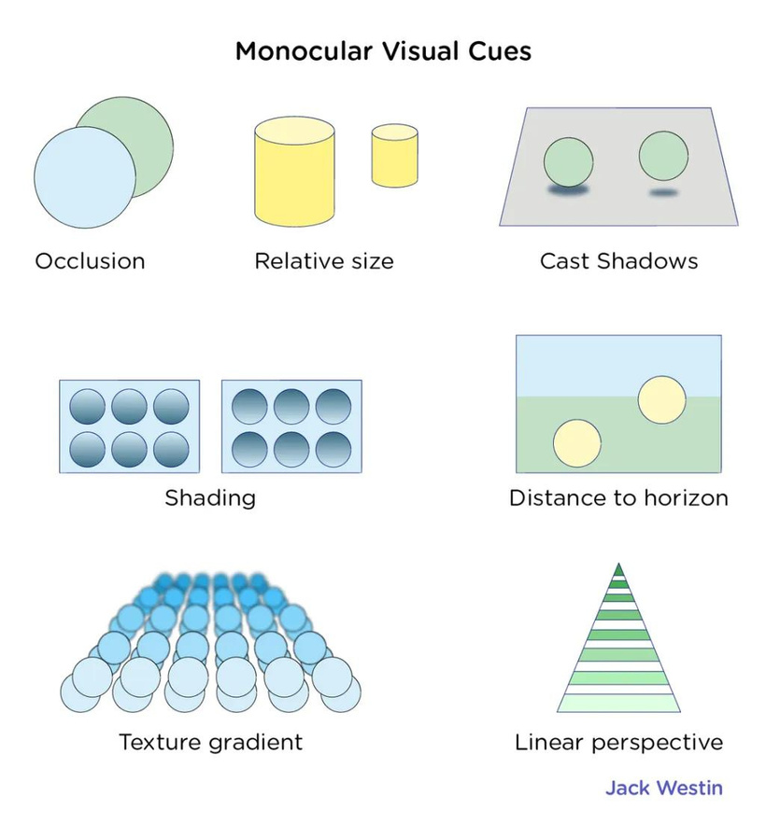
PAST APPROACHES
02
Leveraged features like textures, sizes and occlusions.
Relied heavily on hand-crafted features
Used depth cues such as Vanishing point, shadow and focus-defocus.
Further advancement led to probabilistic graph models being introduced such as Scale-Invariant Feature Transform (SIFT), Pyramid Histogram of Oriented Gradient (PHOG), Conditional Random Field (CRF) and Markov Random Field.
Stereo vision to calculate the disparity.
Stereo matching and triangulation
Cons
Expensive equipment and expertise required to acquire data
Binocular camera based
Wouldn't work if the image captured has poor textures

Slide 4
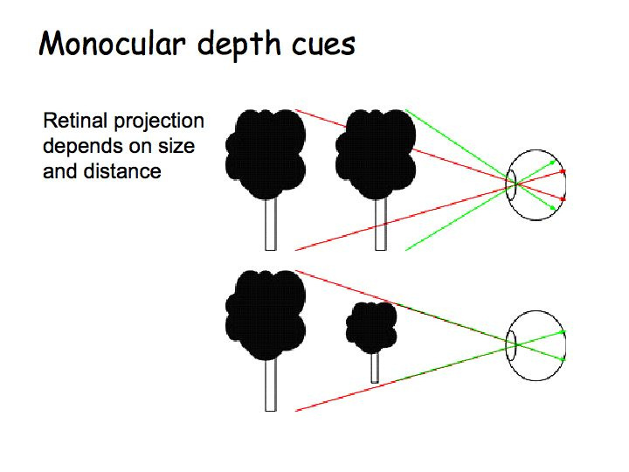
RECENT WORKS IN DEPTH ESTIMATION
03
A single camera to obtain images due to its vast availability and hassle-free equipment or technique.
An encoder-decoder network
The encoder captures the depth features.
The decoder regresses the estimated depth.
To preserve the features of each scale, each encoder and decoder are concatenated with skip connections.
Depth loss constrains the network
Converges once the desired depth map is obtained.
Usually a regression problem but a recent approach treated it as a classification problem.
Uses stochastic gradient descent to train the network with the Adam optimizer.

Slide 5
TWO CATEGORIES OF LEARNING METHODS CAN BE USED TO ESTIMATE MONOCULAR DEPTH
04
Supervised learning
Unsupervised learning
Supervised learning networks work with the Ground Truth data as the label.
It usually penalizes the error between the predicted depth and the ground truth depth.
Loss functions such as Log Depth and reverse Huber.
Brings the predicted depth closer to the actual Ground truth depth with each successive iteration.
Inspired by the traditional stereo-matching methods.
Use left-to-right images to estimate the depth
Trained on pair-wise images, tested on single image
Does not require Ground Truth depth maps
Utilized new loss functions such as appearance Match loss, Disparity smoothness loss and Left-Right disparity consistency loss

Slide 6
MY AIM
05
Implement an end-to-end framework for monocular depth estimation for the indoor datasets, improve the predictions for images with low light and poor textures utilizing a standard encoder-decoder architecture where the encoder consists of high-performance pre-trained neural network combined with appropriate data augmentation policies to help regularize the network.
The first objective is to explore and implement a lightweight encoder-decoder architecture in supervised learning method that will utilize less resources and consume less time to train the network. To maximize performance, some experimentation with hyperparameters is essential. This includes adjusting values such as learning rate, batch size and number of epochs.
The second objective is to come up with a data augmentation strategy that will further help regularize the network. This can be done by observing the performance of the network when tried with different augmentation policies
The third objective is to compare the performance of the implemented framework with the existing recent works. The main aim here is to determine how well the implemented framework performs with less resources and less time to train given that data pre processing helps optimise the learning process.

Slide 7
Thank you!

